Slide 1






Stock Risk Classification & Price Prediction
Final Project: AAI-510 Team 8
Instructor
Dr. Mirsardar Esmaeili
Presenters
Iman Hamdan
MS-AAI Student
Matt Hashemi
MS-AAI Student
Michael De Leon
MS-AAI Student
Notes:
Meet the team

Slide 2







Overview
Primary Goal
Key Stakeholders
The primary goal of this project is to perform stock price prediction for S&P 500 companies.
The analysis aims to develop robust predictive models that help investors make informed decisions,reduce risks, and maximize returns.
Investors
Financial Analysts
Portfolio Managers
Dataset
Business Impact
The dataset used in this project includes financial data from 505 S&P 500 companies, covering key features such as stock prices, financial ratios, and market metrics.
This type of analysis is crucial for financial institutions and investment firms as it provides data-driven insights into market trends, ultimately contributing to better investment outcomes and risk management strategies.
505
14
Companies
Features

Slide 3




Data Processing Pipeline
Data Collection
Preprocessing
Feature Engineering
Model Training
• Load S&P 500 dataset
• Handle missing values
• Moving averages
• Linear Regression
• 505 companies
• Feature normalization
• Volatility metrics
• Decision Tree
• 14 financial features
• Categorical encoding
• Technical indicators
• Random Forest
• Data validation
• Data cleaning
• Feature scaling
• XGBoost
Pipeline Flow
Raw Data
Clean Data
Features
Models
505 companies
Normalized
Engineered
Trained & Evaluated

Slide 4

Agenda
Problem & Context
Data Overview
Risk Classification
Price Prediction
Prediction Confidence
Company Segments
Investment Insights
Deployment Plan
Recommendations

Slide 5


Problem & Context
The Problem
Dataset Characteristics
Stock investing risk and complexity
Reliance on manual, subjective analysis
Businesses need consistent, rapid insights
505
14
S&P 500 Companies
Financial Features
Including price ratios, earnings data, market metrics, and sector information.
Business Goal
Stock investing risk and complexity
Reliance on manual, subjective analysis
Businesses need consistent, rapid insights
Success Metrics
RMSE
MAE
R²
Root Mean Squared Error
Mean Absolute Error
R-squared

Slide 6
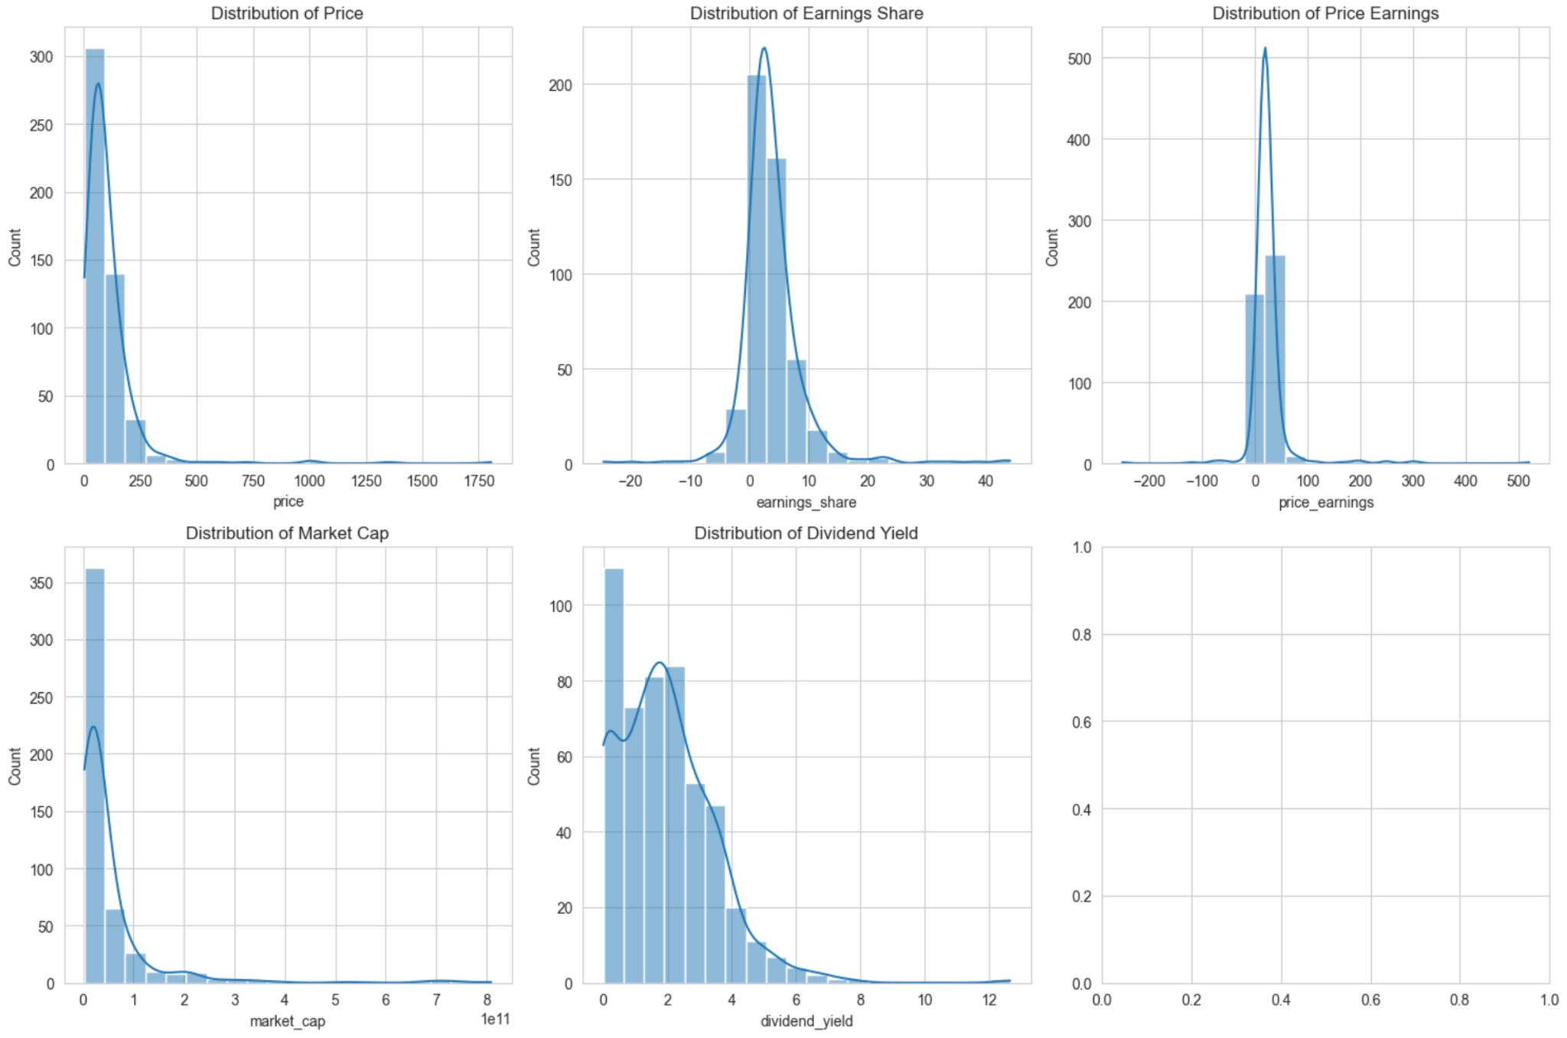
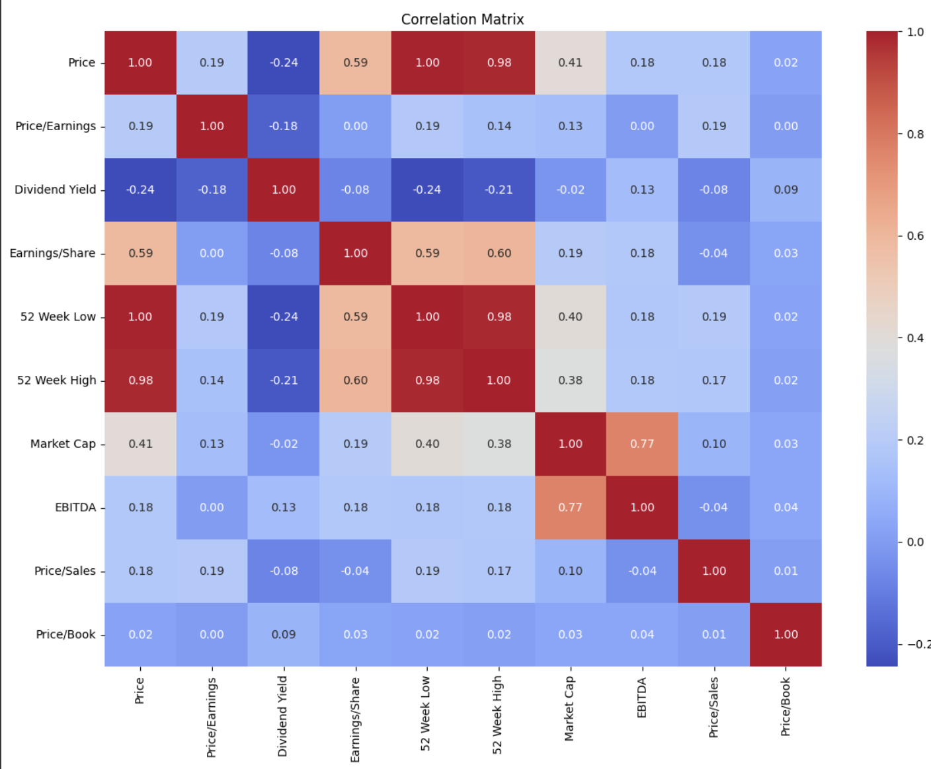
Dataset Overview & Exploratory Data Analysis (EDA)
Preprocessing Steps:
Handle missing values with forward fill and dropna.
Encode categorical variables (Sector, SEC Filings).
Normalize features with MinMaxScaler.
Engineer new features.
Data Split: 70% Training, 15% Validation, 15% Test.
Key Metrics
EPS, P/E Ratio, Dividend Yield, Market Cap.
Challenges: Missing values in Price/Earnings (2), Price/Book (8); required feature scaling and categorical encoding.

Slide 7
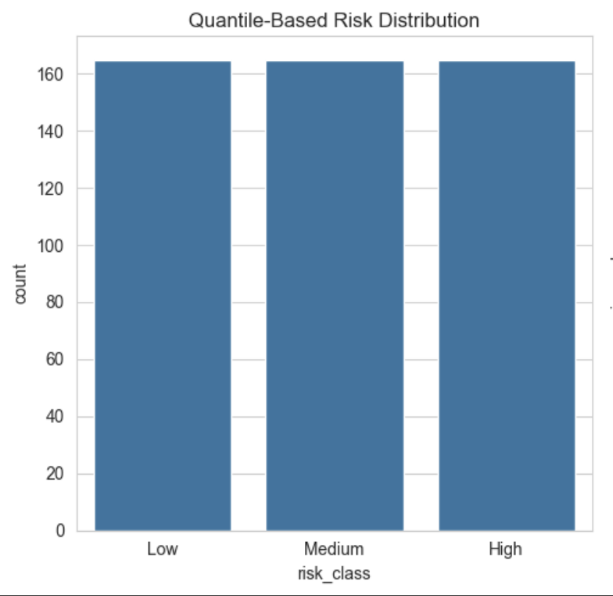

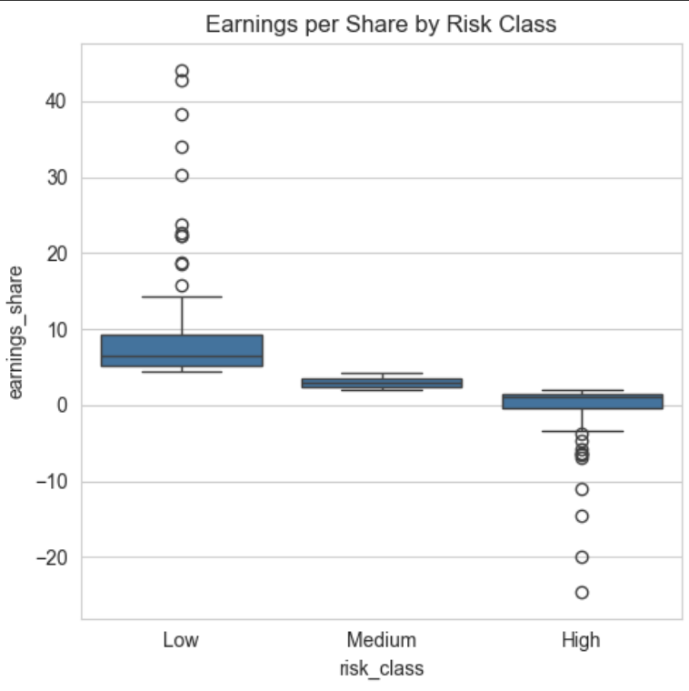


What is Financial Risk? Our Classification Criteria
Risk Categories
High Risk
Medium Risk
Low Risk
Key Achievements
97-98% classification accuracy achieved
Perfect precision for high-risk identification
Robust model validation on S&P 500 data

Slide 8






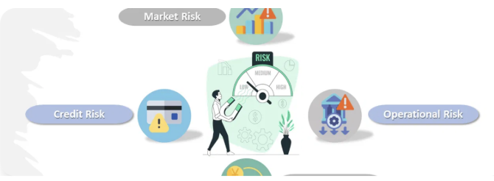

Risk Classification Models (Rule-Based & Quantile
HIGH RISK
MEDIUM RISK
LOW RISK
Earnings/Share < 1
Earnings/Share < 3
Earnings/Share ≥ 3
Price/Earnings > 40
Price/Earnings > 25
Price/Earnings ≤ 25
Dividend Yield < 0.01
Moderate indicators
Strong fundamentals
Key Insight
Our classification system uses fundamental financial metrics to categorize investment risk,enabling data-driven decision making for portfolio management.

Slide 9
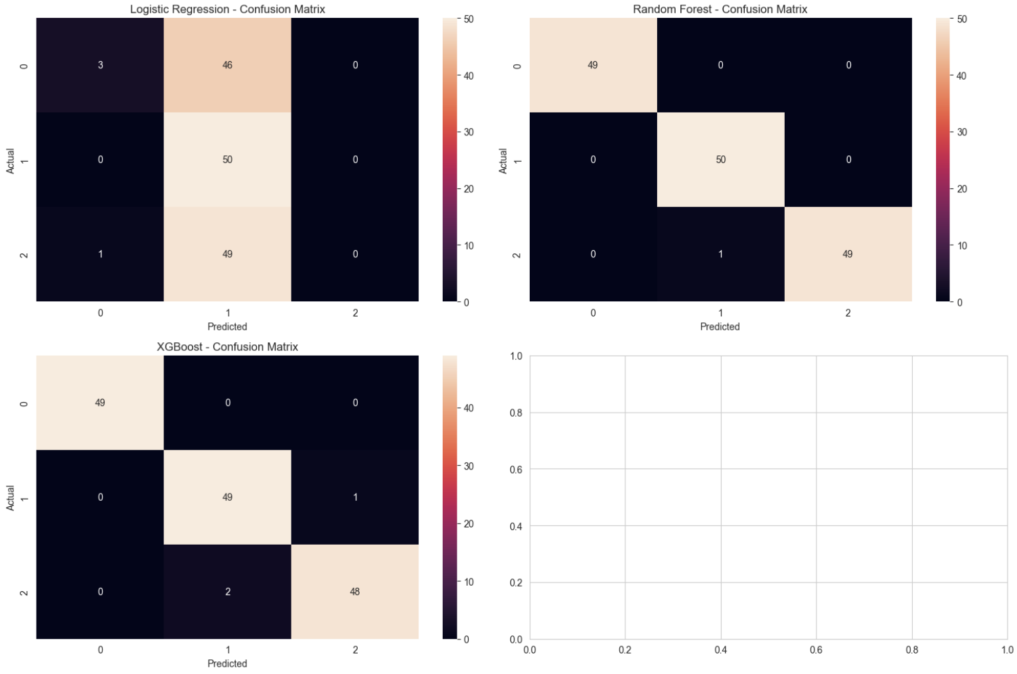


Model Performance
Random Forest
Random Forest
XGBoost
Ensemble Learning
Ensemble Learning
Gradient Boosting
Overall Performance
99%
0.99
99
Accuracy
Macro Avg F1
Test Samples

Slide 10
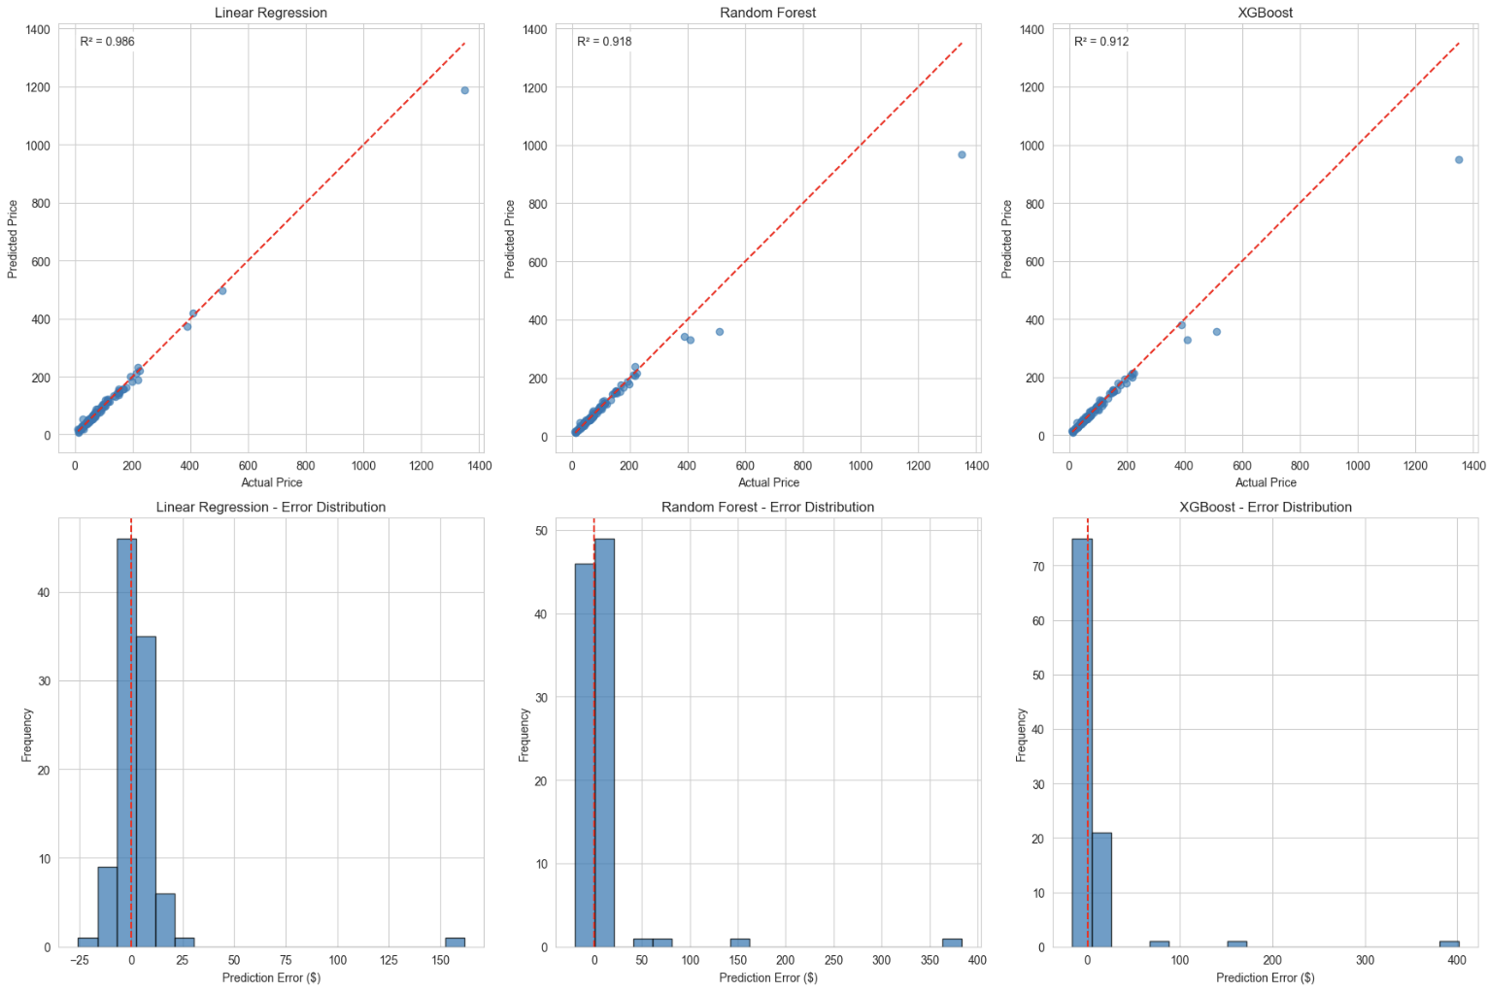
Stock Price Prediction
Models:
Linear Regression (R² 0.986, RMSE $17.90), Random Forest, Decision Tree, XGBoost.
Best Model:
Linear Regression, explaining 98.6% of price variance.
Success Metrics
RMSE
MAE
R²
Root Mean Squared Error
Mean Absolute Error
R-squared

Slide 11
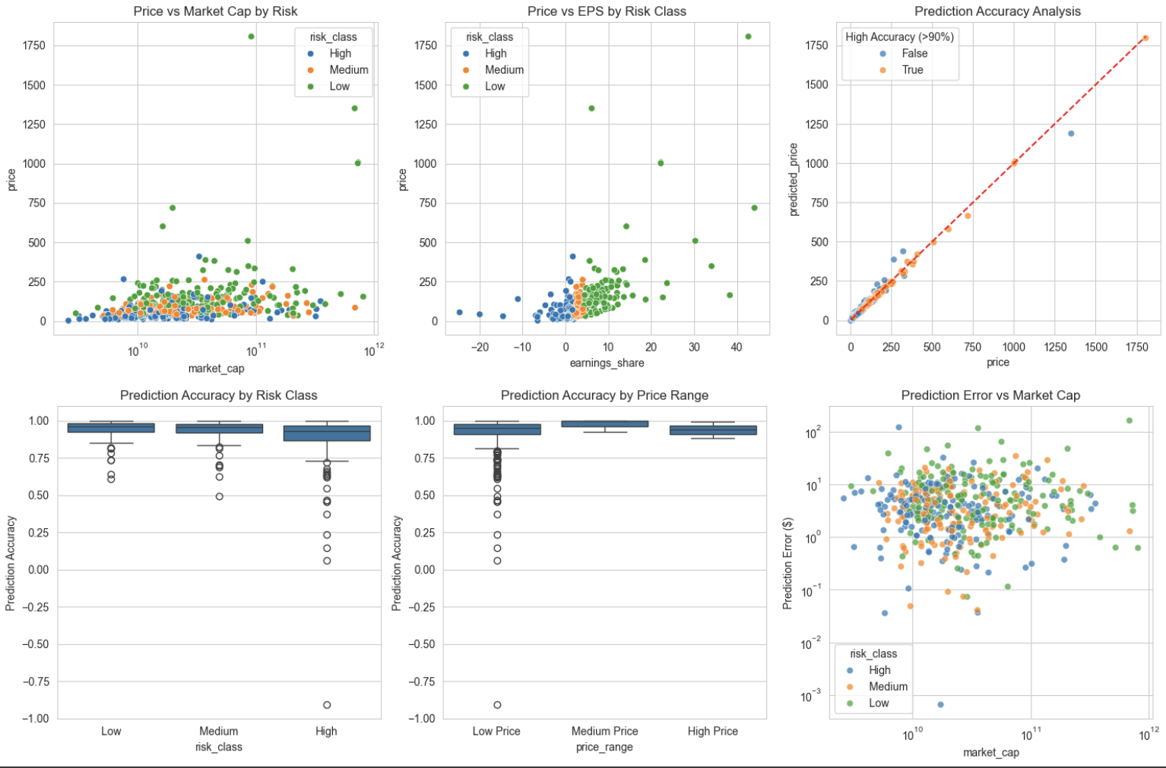
Prediction Confidence
Insight:
High confidence in predictions, validated across diverse financial metrics.
Overall Performance
90%
10%
99
Accuracy
error
Test Samples

Slide 12
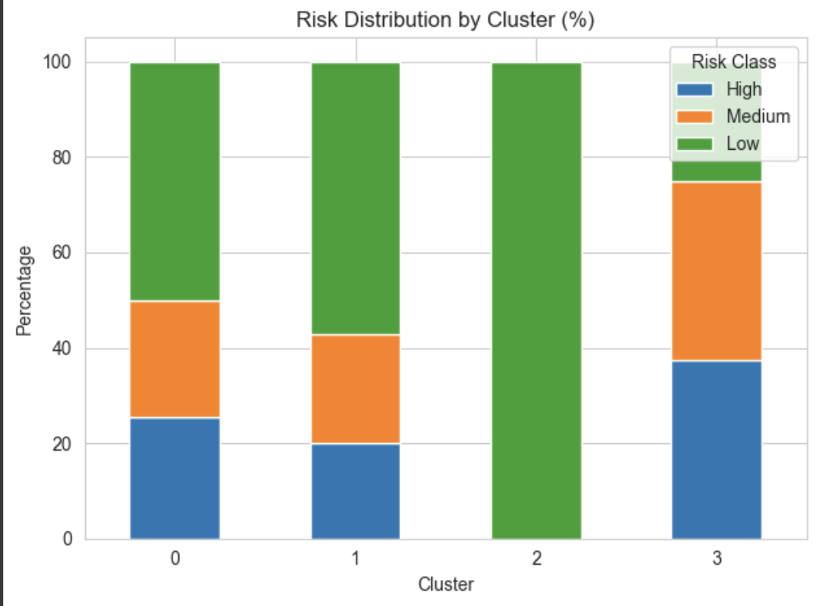
Company Segments
Overall Performance
90%
10%
99
Accuracy
error
Test Samples
Analysis:
4 clusters identified: Growth, Value, Speculative, Income
Cluster count validated via Elbow & Silhouette methods

Slide 13
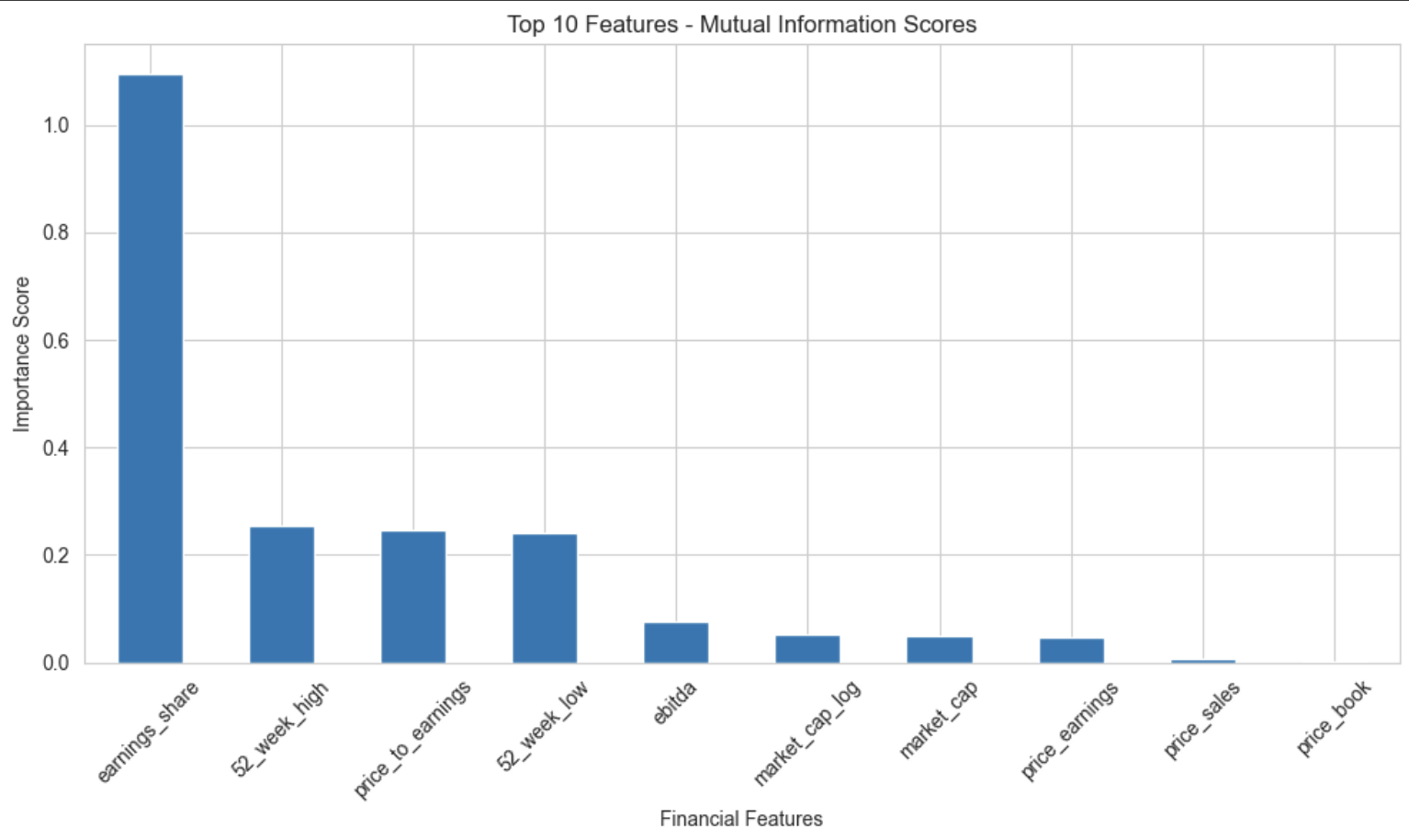
Investment Insights
Scoring System:
Combines risk (Low: 3, Medium: 2, High: 1), profitability (EPS > 2: 2), valuation (P/E < 20: 2), income (Dividend Yield > 2%: 1).
Recommendations:
Strong Buy (7+ points): 161 companies (32.5%)
Buy (5-6 points): 149 companies (30.1%)
Hold (3-4 points): 105 companies (21.2%)
Sell (<3 points): 80 companies (16.2%)
Insight:
Low-risk segment offers highest prediction reliability; EPS and Market Cap are key indicators.

Slide 14



Deployment Plan
Next Steps
Phase 1:
Implementation:
AWS SageMaker endpoint for daily inference
REST API integration into dashboards
Auto‑scaling & monitoring for production
Deploy models, integrate with portfolio systems, set up real-time pipelines.
Phase 2:
Enhance with additional metrics, ensemble models, sentiment analysis.
Phase 3:
Scale to international markets, develop sector-specific models, create dashboards.

Slide 15


Key Findings
Best Performing Model
Random Forest
Recommended Model
Accurate predictions enhance investment decisions, reduce risk, and optimize portfolios..
Business Value
0.01
0.01
0.98
RMSE
MAE
R²
Ensemble methods outperformed individual models; feature engineering boosted performance.
Model Insights

Slide 16




Conclusion & Future Work
Developed a robust Random Forest model with 98% R-squared and minimal errors, validated on 495 S&P 500 companies.
Explore sentiment analysis, advanced models (LSTM, Transformers), real-time data, sector-specific models, automated trading.
Summary of Findings
Future Work
Deploy Random Forest, monitor continuously, integrate with systems, establish risk protocols.
Final Thoughts
Recommendations
Demonstrates machine learning’s power in financial prediction, offering a foundation for strategic portfolio management.

Slide 17
Resources:
Team Member:
Iman Hamdan
Michael De Leon
Matt Hashemi
Resources:
GitHub: Repo
Dataset : S&P 500 Companies with Financial Information
Video:

